Slide 1
FUJI S9100IR (Infrared Digital Camera)

Slide 2
It Is All About Light
Digital cameras have sensors that respond to light wavelengths. The camera’s software converts the information to a “picture” known as a digital image.
The visible light range (that we see with our eyes) is about 400 nm to 700 nm. This is a wavelength of about 400 nanometers to 700 nanometers.
The FUJI S9100IR has been modified to record light from about 400 nm to 900 nm. This means it can record information we can’t see with our naked eyes.

Slide 3
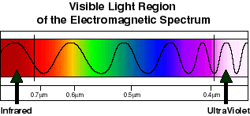
Right about here is what seems to work best for bruises, blood and GSR detection, eliminating blood on a body, furrows in grass.
http://science.hq.nasa.gov/kids/imagers/ems/visible.html

Slide 4
IR Digital Imaging (It is all about CONTRAST)
Tattoo's: there will be a contrast that may make the tattoo stand out.
IR can help show bruising on the human body. It seems to work with dark skin people. I can work on light skin people with some light manipulation.
IR can “shoot through” the blood and/or decomp on a body.
IR can enhance the visualization of bullet holes and furrows in grass, dark surfaces, and trees.
IR can show printing on charred documents and changes in ink on documents.
IR can help visualize blood and GSR on dark substrates.

Slide 5
How Do I Get the IR Light
Light can be emitted, transmitted, or it can be reflected. If something glows, like luminol, it is emitted light. If we shine a light on something the light that comes back to us that we see is generally reflected light. Light that is allowed to pass through a lens or filter is transmitted.
The FUJI S9100IR generally records reflected light information, in terms of IR, and records transmitted light. It will not record heat information, such as that from a human body, because the wavelength of that electro-magnetic energy is around 1350 nm. The Fuji works 400 nm - 900 nm.

Slide 6
IR Light Sources
The Sun is an excellent source.
Incandescent bulbs will provide a certain amount.
The EIKO Ph0toflood Bulb will provide excellent IR Light. Note the Kelvin temperature needs to be in the 3400 range.
The flash on the camera will provide a certain amount.
The Alternate Light Source (ALS) will provide a lot of light that will usually work well for Gunshot Residue (GSR), blood, and bruising.
Note: All images should be taken in normal and IR mode.
Normal and IR can be taken with the FUJI S9100IR. All you need to do is change filters.

Slide 7
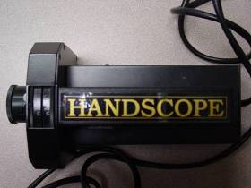
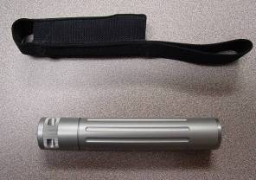
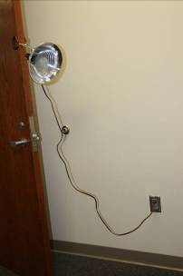
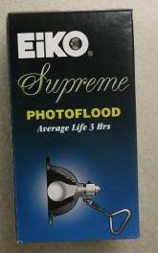
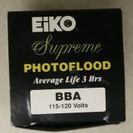
Alternate Light Sources

Slide 8
Setting Up the Fuji IR
Check battery.
Insert media card.
Attach appropriate filter.
Check focus: manual or automatic. In IR mode it may be necessary to manually focus.
You can shoot IR video.
For stills generally start with “P” setting.
Note: Icons are good. When taking images of people you might want to use the portrait icon. The macro icon is good, but be aware of camera movement (i.e., use a tripod).
Set the visualization to the screen.
Apply light for reflected light (green or red from the ALS), or direct from the photo flow, if ambient light is not sufficient.
Check to see if there is a useful image.
Focus and shoot.
Note: extreme sensitivity to movement.
Note: the focal length for close-up images should be set at 28 mm, the widest setting for the Fuji IS-1.

Slide 9
Fuji Camera Settings
power switch
aperture
shutter
manual
program
video
auto

Slide 10
Fuji IR Buttons
Display toggle
Fine focus
Fine focus
Quick switch to set ISO, file size, and color mode
menu

Slide 11
Fuji IR Buttons
auto focus
Manual focus switch
Macro switch
One time focus: good for manual

Slide 12
Taking An IR Image
Apply the appropriate filter: IR Filter
Set the camera to “P” and try an image with visible light. Then try an image with the on-camera flash. Then set the color mode to BW by f then STD then menu> then BW. Try with and without on-camera flash.
Apply green (590 nm) or red (615 nm) light from the light source to the target. You will most likely need to manual focus and time expose. Or, use an IR light or the Photoflood Bulb source. Take images. Have the target, if living organism, cover eyes.
Images taken in the STD color mode may have a pink hue. Images taken in the BW mode will be grey and white.
The on camera flash seems to provide sufficient light for close-up images of blood.

Slide 13
A Word About Light Intensity
The rule for intensity is 1/X².
This means if the light is a 2 feet and you move it away to 4 feet the intensity will ¼ at 4 feet what it was at 2 feet. So, if you move from 4 feet to 2 feet it will be 4 times as great.
If you do not see much of an image, move the light closer or time expose. If you cannot get auto focus due to intensity of light, manual focus and time expose.

Slide 14
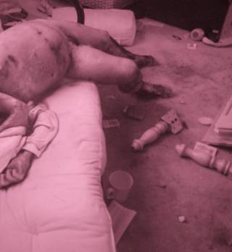
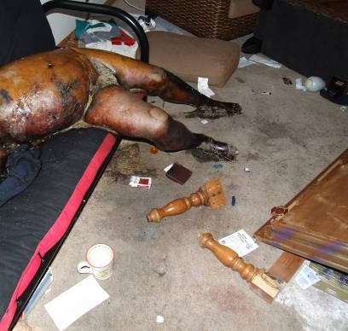
IR, available light, STD color mode, “P” setting.
Normal Color, STD mode, flash, “P” setting.

Slide 15
Domestic Assault Victim
Bruising, consistent with blood vessels.

Slide 16
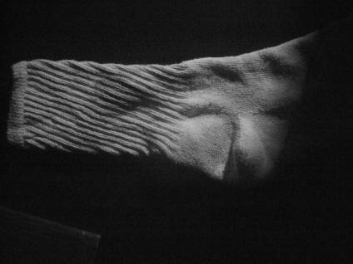
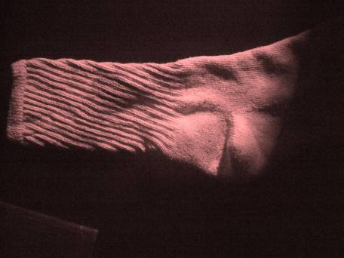
Blood on Black Cotton Sock
Image adjusted using levels red channel.
Image adjusted using auto levels

Slide 17
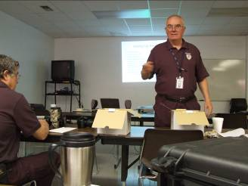
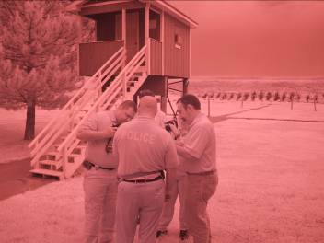
Crime Scene Tech Training
Note black uniforms with standard color images.
IR image: note the grass appears light colored as does the blue tower and the black uniforms.

Slide 18
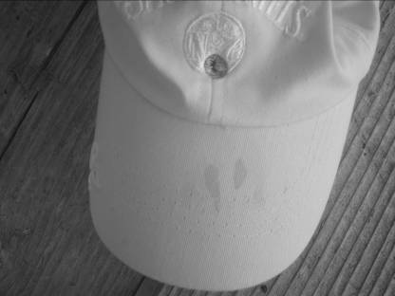
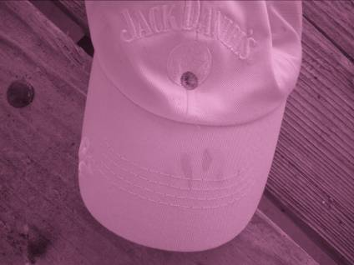
Black Cap with Bloodstain and Bullet Impact
The Fuji IS-1 allows IR images in B & W Mode or STD mode.

Slide 19
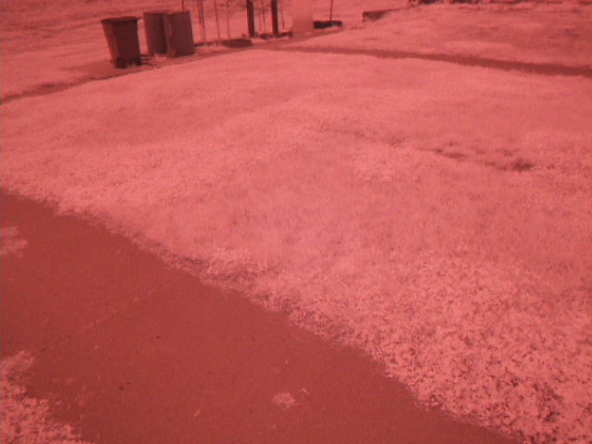
Bullet Impact on Concrete and Furrow in Grass
Furrow
.40 cal impact

Slide 20
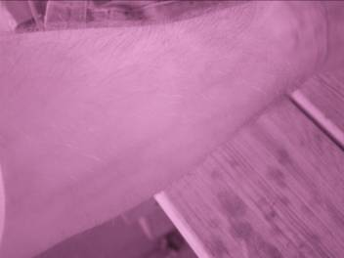
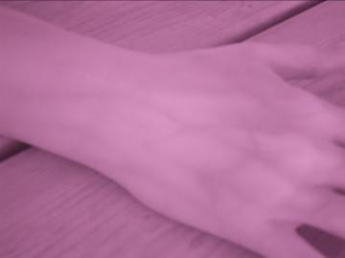
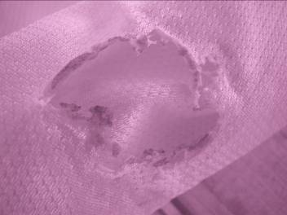
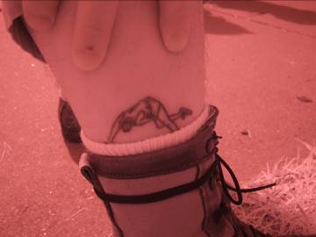
IR Images (note different hue)
Male arm
Female hand
Dark blue umpire shirt with burned area.

Slide 21
For What It is Worth: Tips of the Trade
The Fuji can be used to record video in IR.
The IR mode is very sensitive to movement. Consider using a tripod.
Manual focus may be necessary. Do to the nature of IR imaging, auto focus may not work.
The silver dome light works very well for most applications. Bracket by moving the light closer or farther from the target, and by reflecting the light at different.

Slide 22
UV Light with the Fuji IS-1
You can only get near UV images. This is usually accomplished by setting the camera to standard, use the hot mirror filter, put on an orange filter, and illuminate the target with CSS down to 415 nm.
This is what we do when we search for semen, GSR, fluorescent fingerprints, and fluorescein. Tripods may be required.

Slide 23
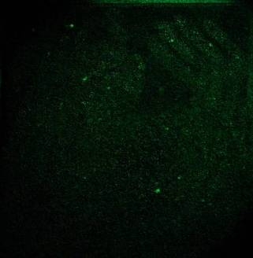
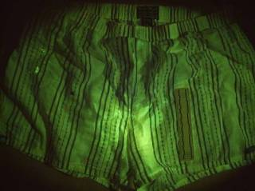
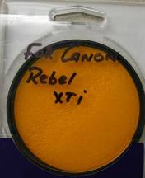
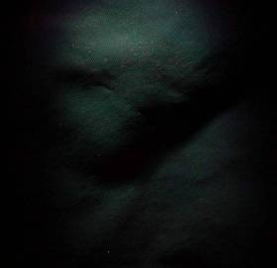
UV Examples
Semen, Urine, Blood
Fluorescein
GSR

Slide 24
UV Otherwise
A camera capable of short wave UV, less than 400 nm, is needed for that photography.
The FUJI IS Pro is a camera that is capable of short wave UV and long wave IR. Attach the adaptor ring for use of ring lights.
It is necessary to add the right light for short wave UV. This can be done with ring lights, the photoflood bulb, or an ALS.
Be sure to take off any IR filter, put on the cut filter, and an orange barrier filter for near UV.

Slide 25
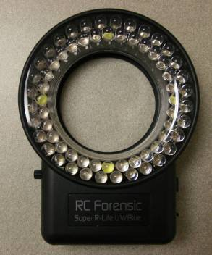
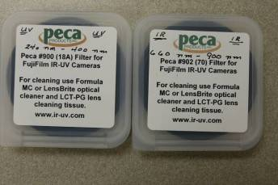
The FUJI IS Pro

Slide 26
UV Photography
UV can be useful for showing bruises on light skin people, light colored footprints on white tile, and fluorescing materials.
It usually requires a tripod and time exposure.
Always use a scale and marker with all IR and UV photography if you intend to document detail or size.

Slide 27
Have A Nice Day
http://insects.ummz.lsa.umich.edu/fauna/michigan_cicadas/Periodical/Index.html

